Slide 1

Should we sign a contract with Magist ?
NO!

Slide 2
Concerns & approaches
Tech diversity
1. Suitability for high-end tech products
Tech Order behavior
Tech Sales & Revenues
Delivery performance
2. Maintaining fast delivery efforts
Customer Feedback

Slide 3
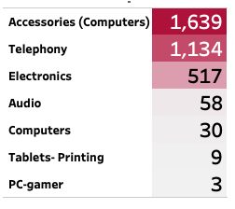
10 % of the products are Tech-related
Tech diversity
Tech Categories
Low Tech Inventory
Focus on Other Sectors
No sign of high-end products

Slide 4
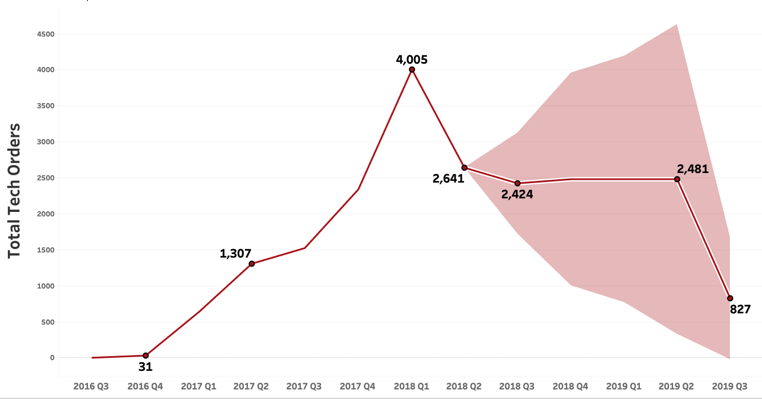
15 % of the orders are tech-related and this tendency is declining rapidly
Tech Orders behavior

Slide 5
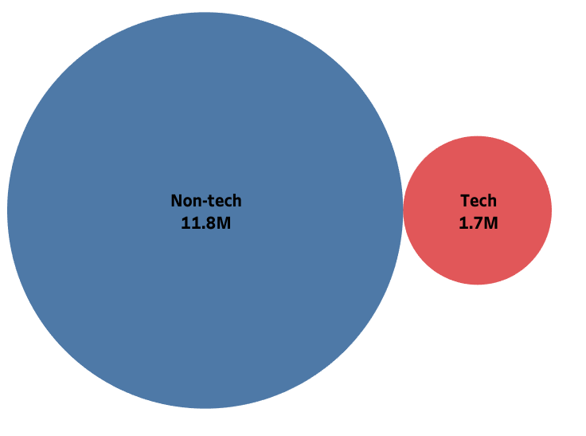
Non-Tech Sales Outshine Tech Sales
Tech Sales and Revenues
Tech sales account for only a minor portion of the total revenue
Tech sellers may bypass Magist as a sales partner.
of total sales in 25 months

Slide 6
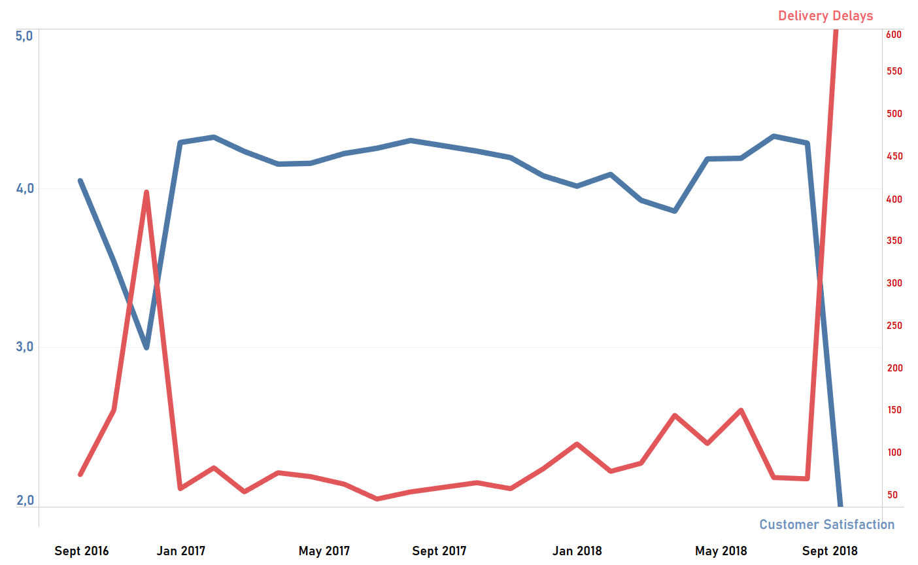
Delivery delays negatively influence customer reviews

Slide 7
Magist shows:
A deal with Magist will lead to:
Unreliability in handling high-end tech products
Unstable sales & weak ordering trends
Inefficient delivery service
Decreased customer satisfaction
Damaged reputation and loss of revenues

Slide 8
Appendix

Slide 9
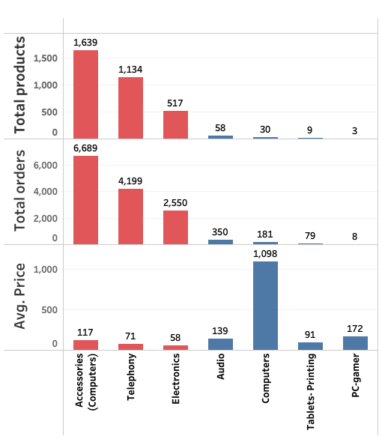
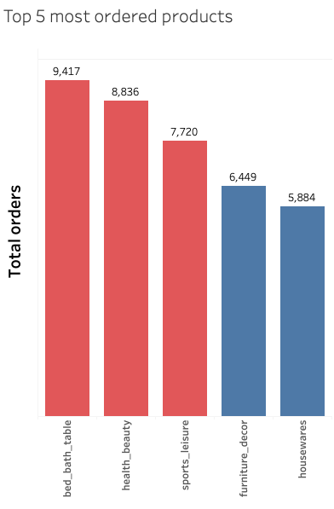
Related to products & orders

Slide 10
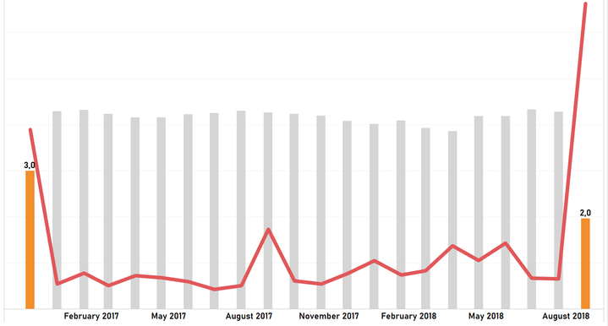
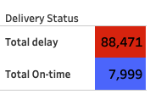
Related to delivery performance

